Slide 1
RAMCO INDUSTRIES LIMITED
SHEET STACKING WITHOUT STRETCH WRAP

Slide 2
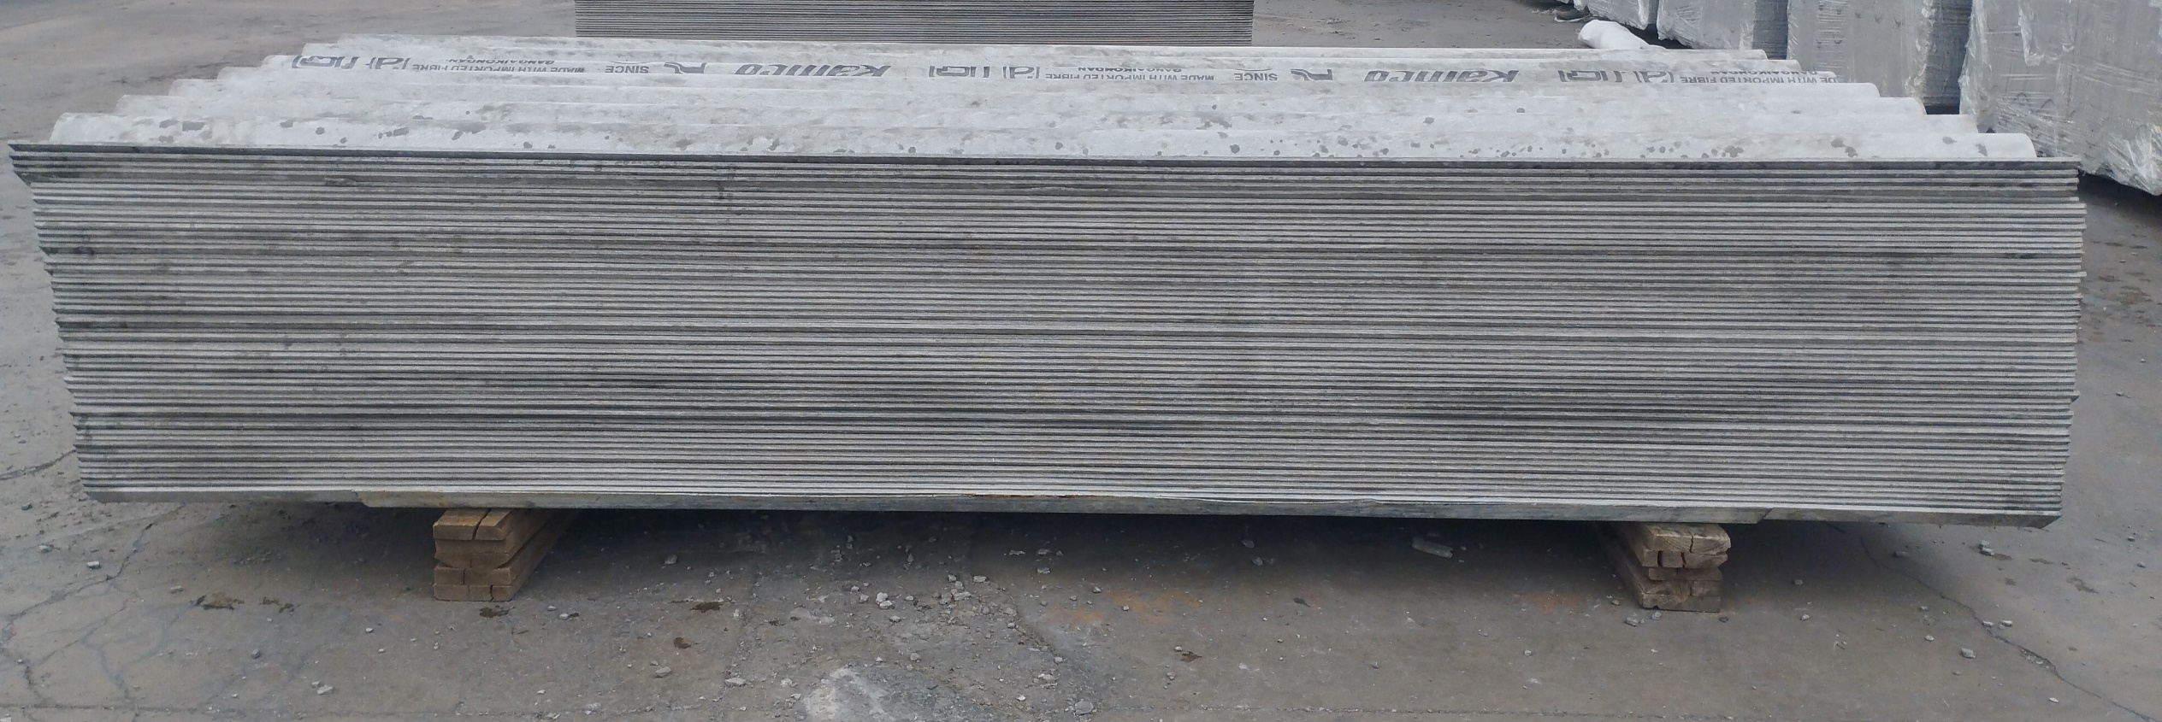
2.50m - Up lap- 52 No's

Slide 3
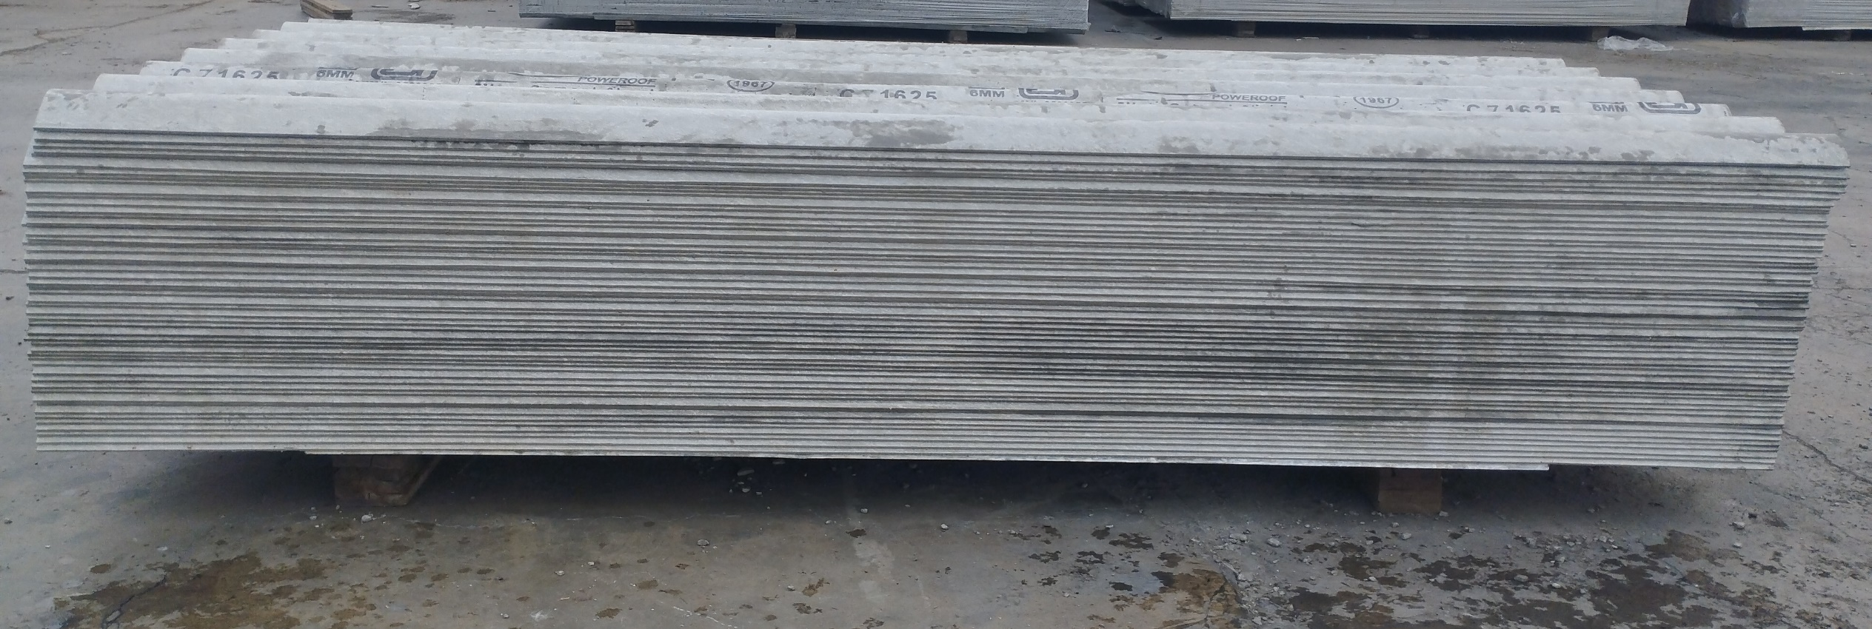
2.50m - Down lap- 52 No's

Slide 4
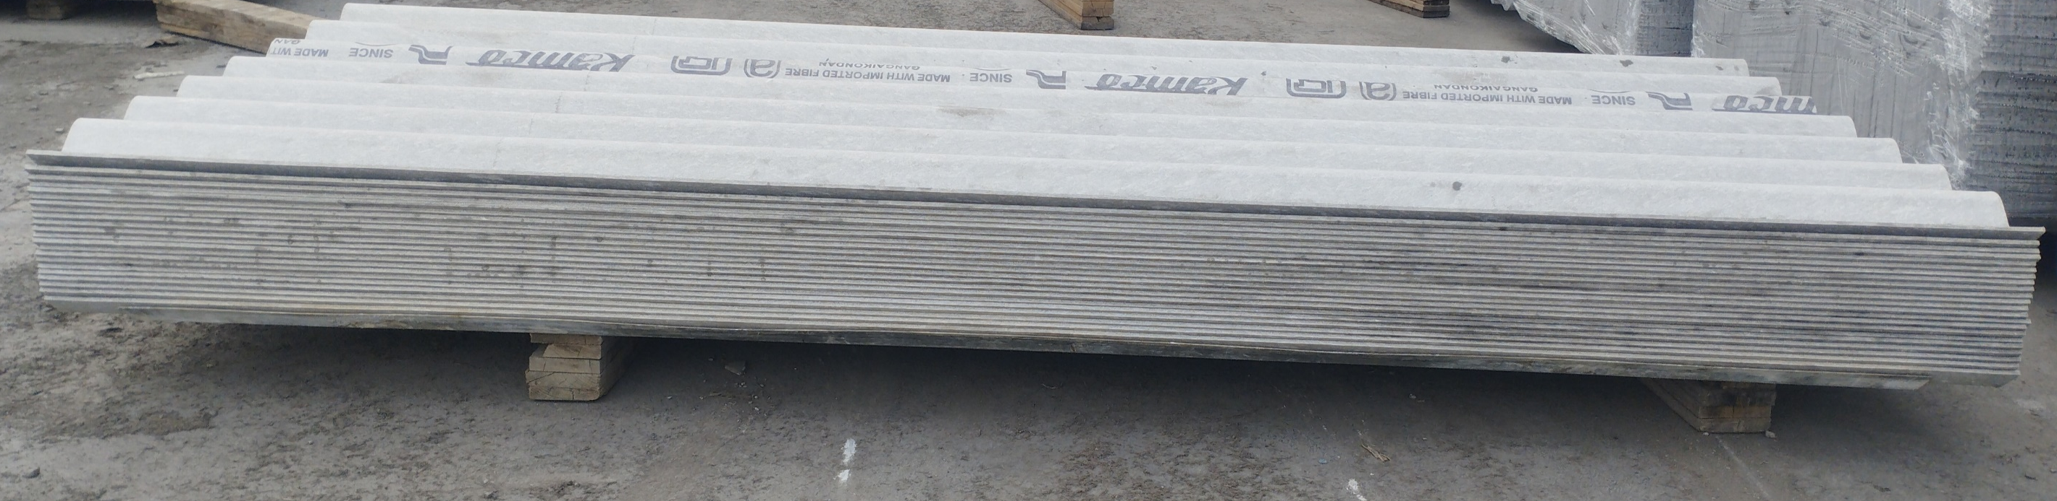
2.50m – Up Lap - 22 No's

Slide 5
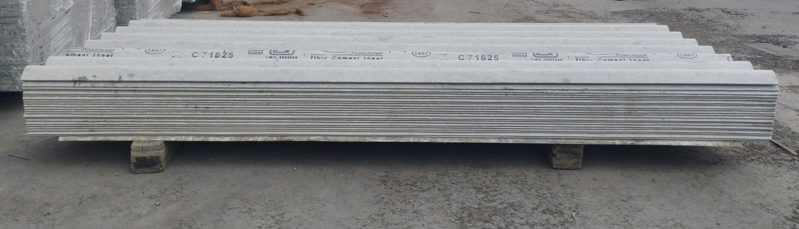
2.50m – Down Lap - 22 No's

Slide 6
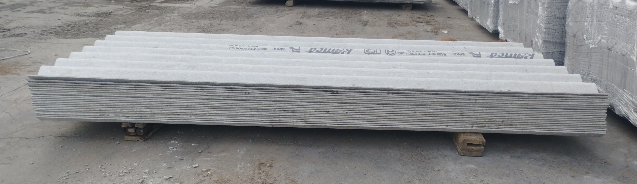
2.50m - Up Lap - 21 No's

Slide 7
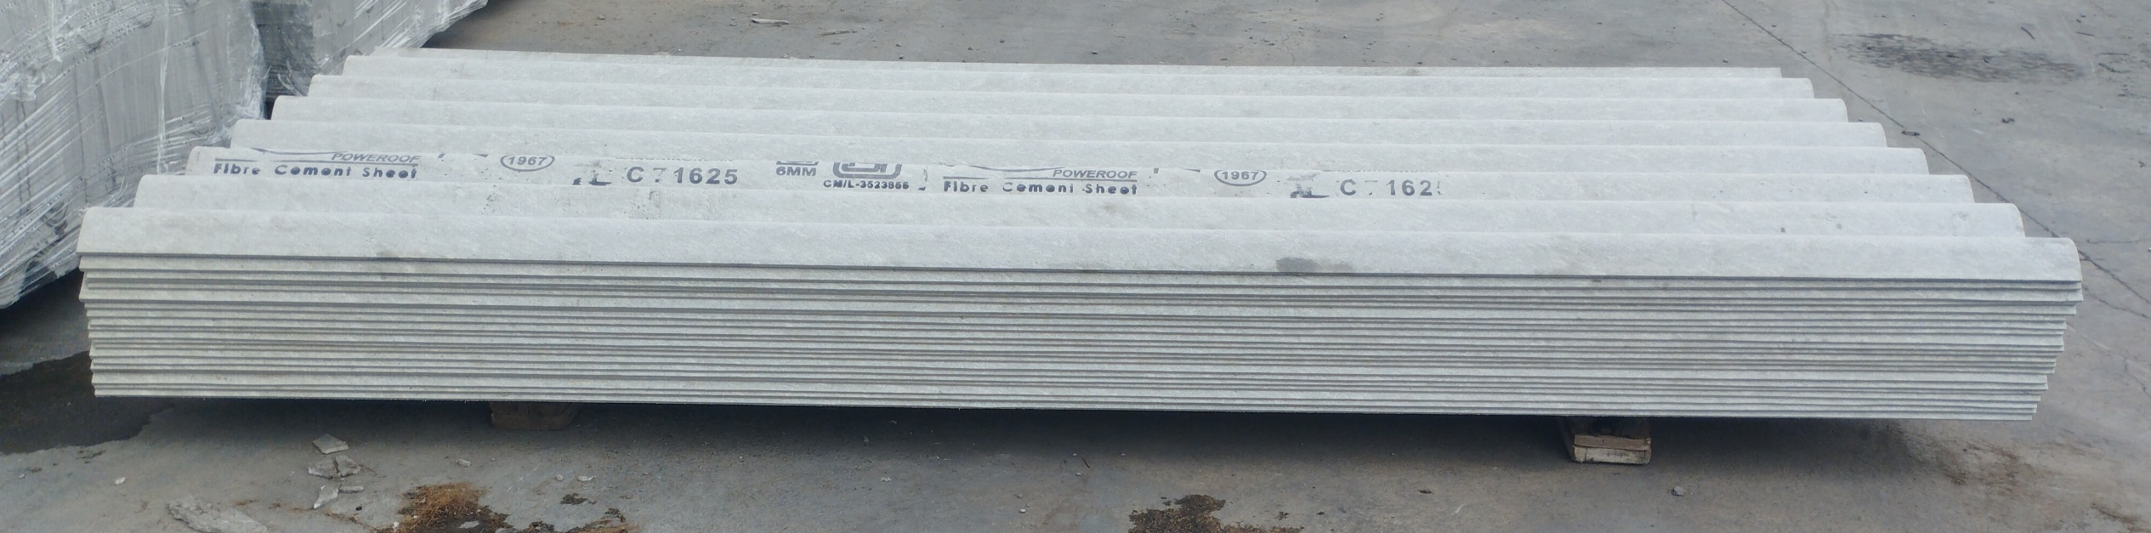
2.50m - Down Lap - 21 No's

Slide 8
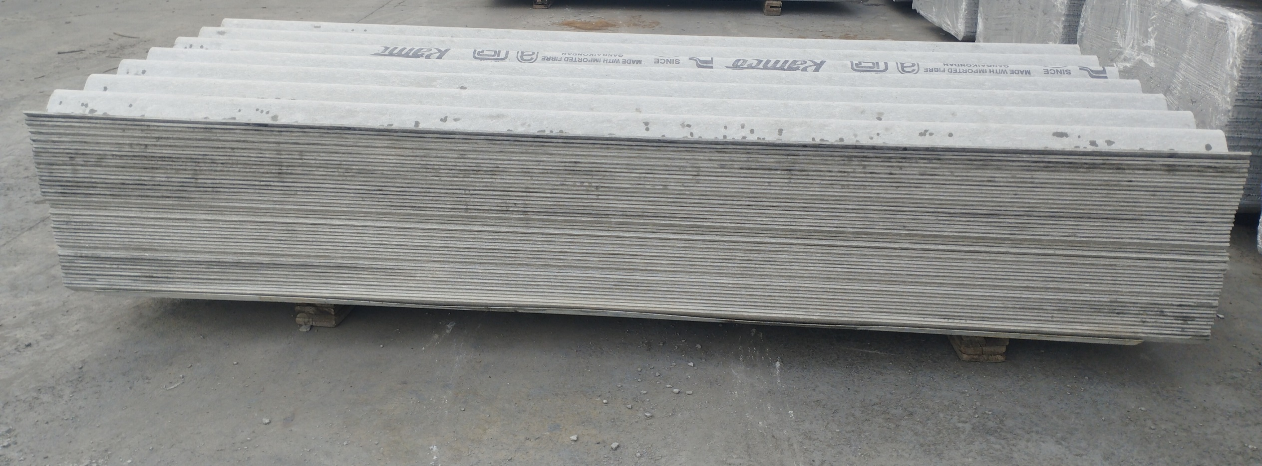
2.50m- Up Lap- 47 No’s

Slide 9
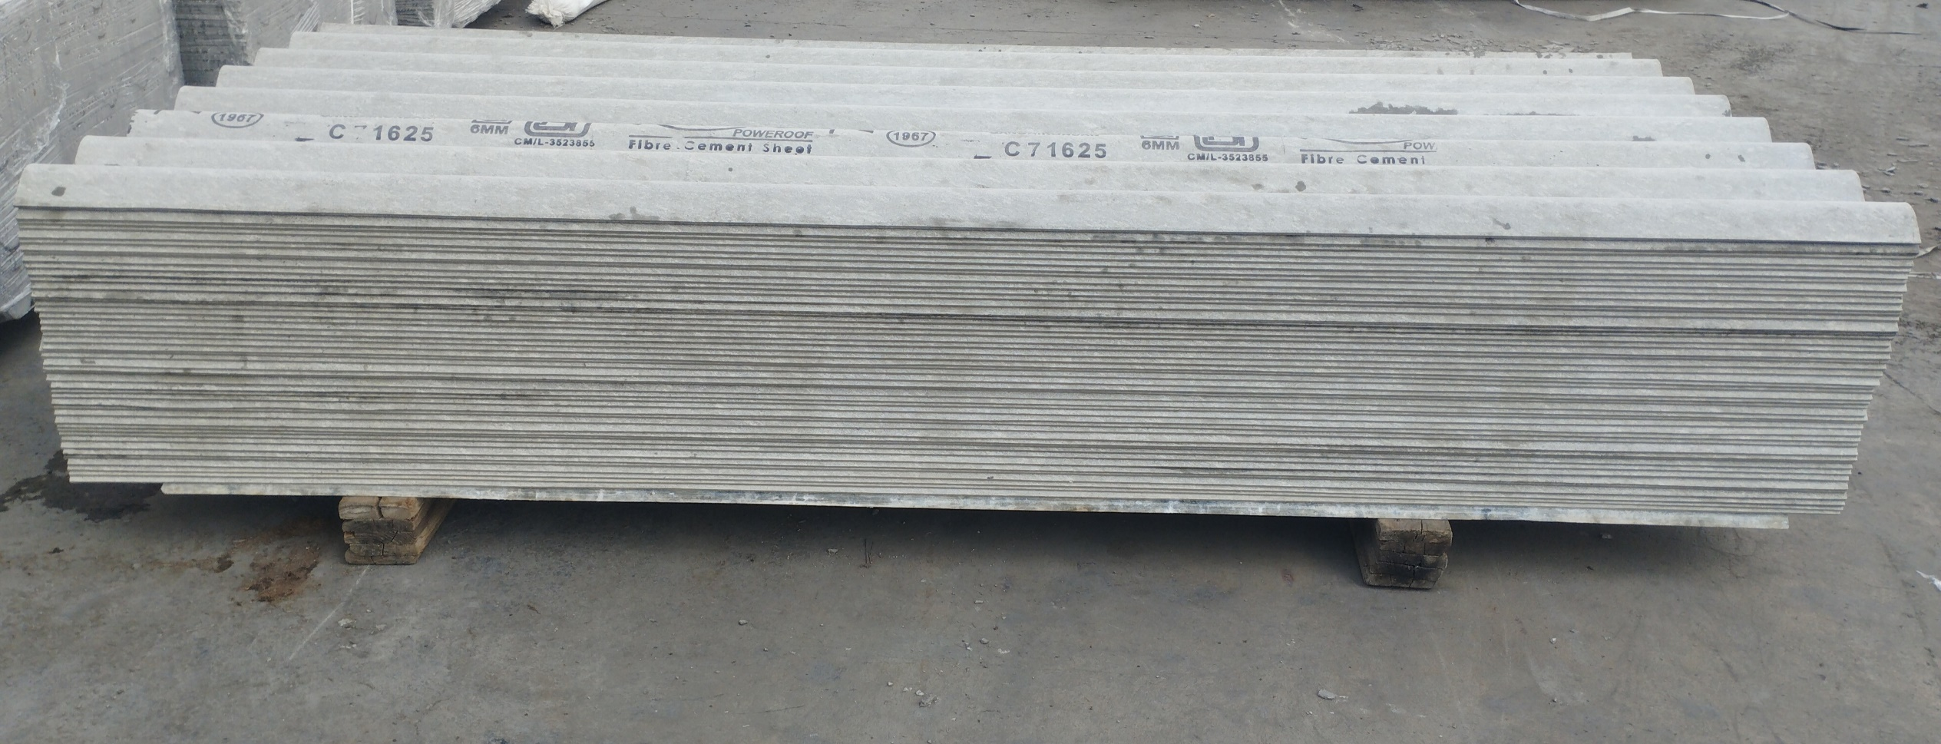
2.50m- Down Lap- 47 No’s

Slide 10
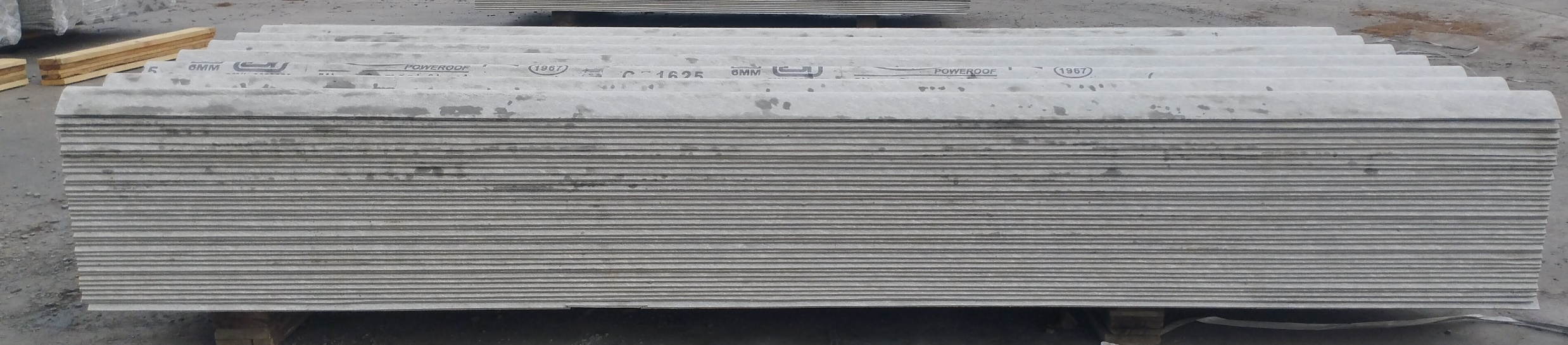
2.50m-Downlap-38 No's

Slide 11
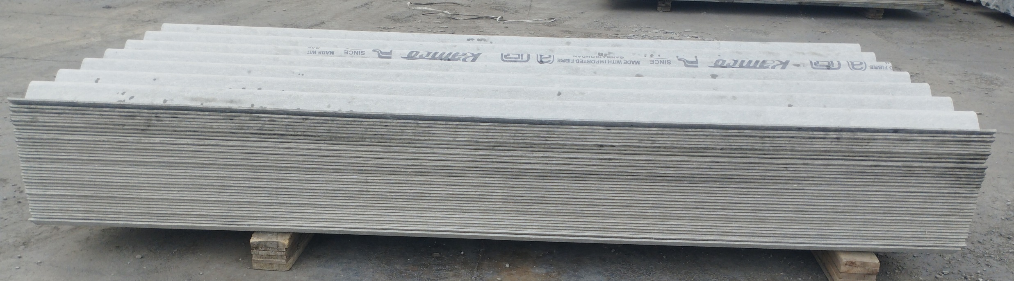
2.50m- Up Lap-38 No's

